Slide 1
Project 1.1
Phase 2

Slide 2
Main topics
Process during the weeks
Interaction between parts of the program
Playable Tetris-like game
The highest score for 12 pieces
Bot playing the game
Further possible improvements
Average highscore

Slide 3
Process during the weeks
Individual research on game rules etc.
Completion of the game
The highest score for 12 pentomino pieces
Completion of the bot
Smaller additions to the bot and the game

Slide 4
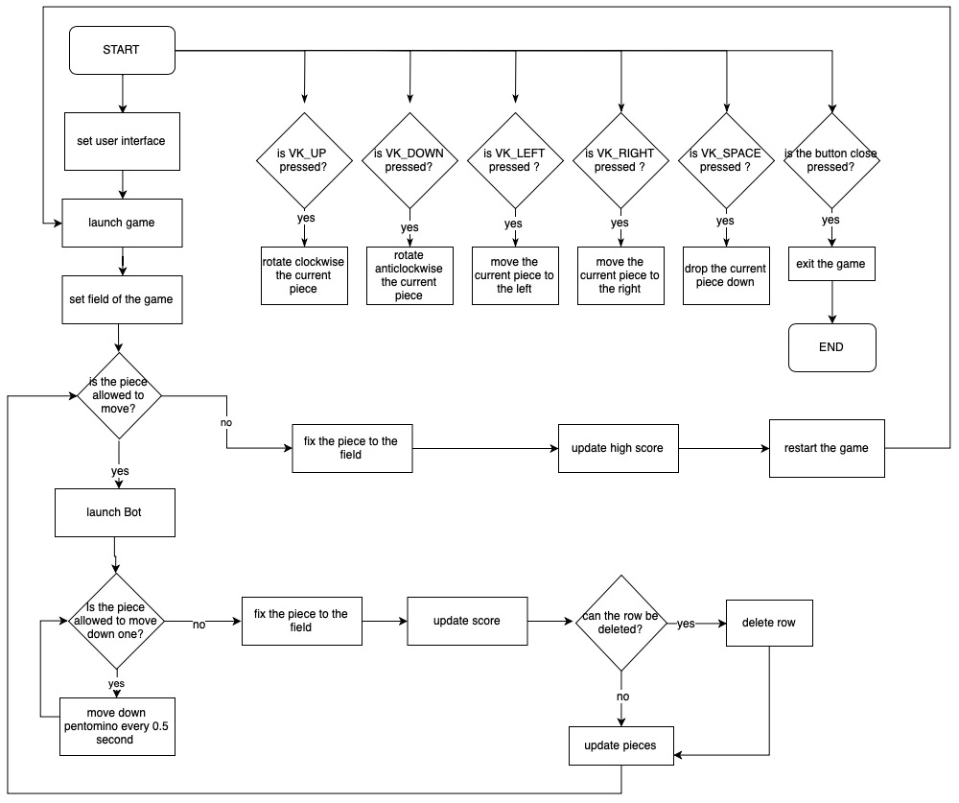
Flowchart

Slide 5
Interaction between parts of the program
Game
HighScores
Piece
UI
Bot
HeapSort
PossibleMove

Slide 6
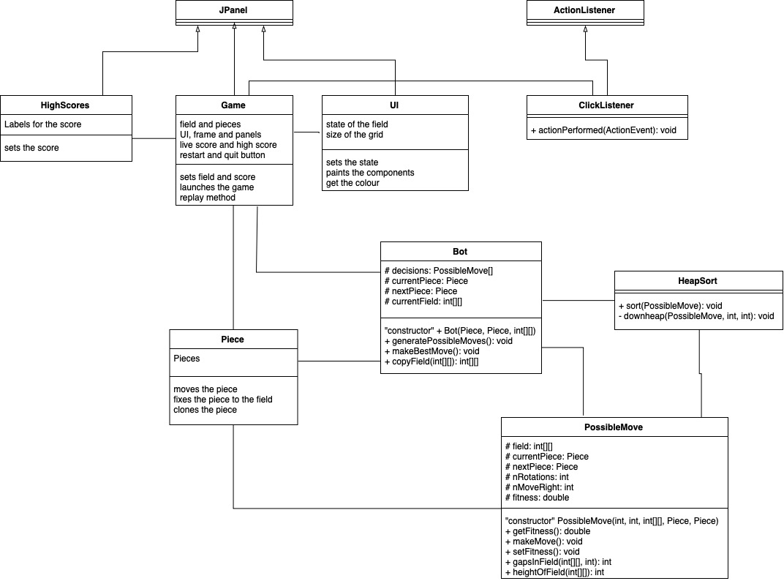
UML Diagram

Slide 7
Bot Playing With Best Order
Bot Playing With Random Pieces

Slide 8
Bot playing the game
Creates a clone of the field for every possible move
Calculates the fitness of each move
Bot carries out the best move

Slide 9
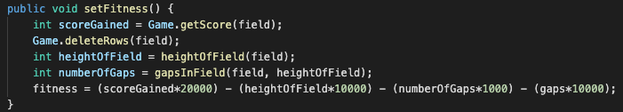
Fitness

Slide 10
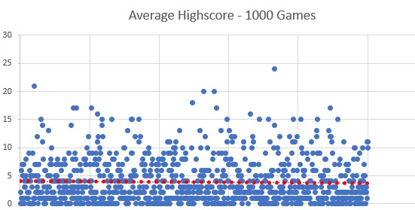

Slide 11
Further Possible improvements
Find best weights for fitness formula using a Genetic Algorithm
Find best order based on optimal fitness formula
Take the next piece into account while calculating the move

